Slide 1
Stay Tranquilo
Monetizing Culture, Building Community, and Scaling Impact
Prestige Worldwide Consulting (pWc) | Team 5
03/21/2025
Notes:
““Good morning, everyone, and thanks for being here. We’re Team 5 from Prestige Worldwide Consulting. Today, we’re sharing our strategic recommendations for Stay Tranquilo—an established digital media brand rooted in Latino culture that’s helping people stress less and live more. Our focus? Helping Stay Tranquilo sharpen their identity, grow their audience, and monetize what they’ve built in a sustainable, community-driven way."

Slide 2
Executive Summary
Problem Statement & Why It Matters
Problem: Stay Tranquilo has a unique opportunity to strengthen its market position and unlock sustainable monetization by defining a clear brand identity and aligning content with its ideal audience.
Why It Matters:
  A well-defined brand identity enhances revenue potential.
  Targeted content increases engagement and loyalty.
  A distinct niche helps differentiate from competitors (Mitú, My Cultura).
Key Recommendation:
  Adopt a clearer brand positioning and align content strategy to drive engagement and monetization through cultural authenticity and community-driven partnerships.
Outcome:
  Stronger brand identity and audience engagement.
  Monetization through community-driven partnerships.
  Scalable business model beyond traditional ad revenue.
Notes:
"Stay Tranquilo has an incredibly well thought-out brand vibe and philosophy—a brand on the verge of that major breakthrough or sharing the next viral video --but right now, we feel that you are missing a few key things: a clearly articulated brand position and a content strategy to turn that identity into sustainable revenue. Why does this matter? Because without direction, it’s tough to compete with established players like Mitú or My Cultura. Our recommendation is simple but powerful: tell the world who YOU are, align your content and revenue models, and scale through cultural authenticity. Remember – you’re not just trying to RDACH 3rd and 4th generation Latinos – you ARE 4th generation Latinos.“

Slide 3
Industry & Competitive Analysis
U.S. Hispanic Market:
60M+ people, $2.8T spending power (2026).
Over-indexes on digital content.
Competitive Landscape:
Mitú & Remezcla – Viral but lacks engagement.
My Cultura – Corporate but lacks lifestyle focus.
Stay Tranquilo's Opportunity – Owns lifestyle, wellness, & community.
Refer to Appendix A for-Landscape chart
Notes:
"Let’s talk market. The U.S. Hispanic population is over 60 million strong, and they’ve got $2.8 trillion in buying power, or at least they will by 2026. They consume more digital content than non-Hispanics, and they’re craving brands that speak their language—literally and culturally. Stay Tranquilo has an edge here. While competitors like Remezcla and Mitú have size, they’re often too broad or too corporate. Stay Tranquilo can win on community, connection, and culture.“
https://www.elfaonline.org/news-and-publications/industry-news/read/2024/09/26/hispanic-heritage-month--the-power-of-u.s.-hispanic-consumers-and-businesses
NiemanLab. “Mezcla Media is lifting up Latinx audio storytellers.”
https://www.niemanlab.org/2022/06/mezcla-media-is-lifting-up-latinx-audio-storytellers/
Forbes article on branded partnerships:
https://www.forbes.com/sites/veronicavillafane/2021/08/05/remezcla-expands-digital-brand-content-strategy/
Sponsorship case study:
https://remezcla.com/brand-partnerships/
Crunchbase: https://www.crunchbase.com/organization/mitu Variety Article:
https://variety.com/2020/digital/news/we-are-mitu-acquired-what-it-means-1234764280/ Podcast business case:
https://wearemitu.com/mituverse/

Slide 4
Methodology
How We Arrived at Our Recommendation
Decision-Making Criteria:
Market & Competitive Analysis
Audience Insights
Monetization Potential
Industry Trends
Feasibility & Execution
Data Sources:
Hispanic media consumption reports
Competitive benchmarking
Engagement data
Latino culture thrives on connection: Stay Tranquilo must be a cultural hub
Notes:
"Our recommendations aren’t based on guesswork. We did the legwork. We analyzed media consumption trends, studied the competition, reviewed engagement metrics, and looked hard at monetization models that actually work for brands in this space. Our decision-making criteria focused on feasibility, revenue potential, and how well the ideas align with Stay Tranquilo’s authentic voice."

Slide 5
Strengthening Brand Positioning
Refer to Appendix B, C, D, E, F, G, H
Positioning Statement:
Among bicultural Latinos (ages 25–45, income $80,000+) who actively engage in digital content for relaxation, inspiration, and connection, Stay Tranquilo is the premier Latino lifestyle and wellness brand that helps ease Hispanics’ and Latinos’ anxieties by staying true to their roots, blending cultural authenticity with community engagement.
Messaging Shift:
From “A media brand” → To “A movement for Latino wellness & connection.”
Align content with authentic storytelling, nostalgia, and lifestyle inspiration.
Notes:
"Here’s how we take Stay Tranquilo from digital media company to a lifestyle movement. We reposition Stay Tranquilo as THE go-to lifestyle and wellness brand for bicultural Latinos—especially those aged 25 to 45, who are juggling stress, identity, and digital overload. We anchor the message in cultural pride and emotional relief. Instead of just 'a cool podcast network,’ Stay Tranquilo becomes a space to feel at home across multiple platforms. Think less 'media brand'—more 'Latino wellness and lifestyle movement.'"

Slide 6
Audience Segmentation
Who Stay Tranquilo Should Target
Primary Target: Young Latino professionals (24-35).
  Seeking balance between career & culture.
  High digital engagement - ideal for social & video-first content.
Secondary Target: Latinas in wellness & career.
  Growing demand for mental health & self-care content.
  Potential for Latina-led podcasts & collaborations.
Bicultural Latinos crave relatable, lifestyle-driven content - Stay Tranquilo can fill that gap.
Refer to Appendix B, C, K
Notes:
"Our primary audience? Young Latinos—ages 24 to 35—who spend tons of time online and are trying to balance hustle culture with their heritage. Secondary? Latinas, that’s right, WOMEN, who are focused on wellness and self-care. This group is growing fast and they are hungry for representation.in this space. Latina-led podcasts, mental health content, and Spanglish storytelling will hit hard. Let’s talk about women for a second. At the center of every Latino story is a mother or abuela guiding it forward. Latina moms and abuelas hold more than families together—they hold generations. They’re not just caregivers—they are the soul of the community, the cultural anchors, storytellers, and quiet leaders of our communities. You cannot build a brand based on community without Latina women. They will not only listen—they will share and they will build community. And they will BUY. They will buy for themselves. They will buy for their husbands and partners, and they will buy for their children and families. "

Slide 7
Monetization Strategy
How Stay Tranquilo Will Generate Revenue
Partner with small, Latino-owned, community-oriented businesses (e.g., cigar brands, coffee roasters, lifestyle products) to develop exclusive collaborations.
Utilize print-on-demand and outsourced manufacturing to market Stay Tranquilo merchandise without absorbing inventory risk while testing demand (Teespring).
Implement an affiliate marketing model by partnering with high-end brands in line with lifestyle products (Amazon, Shopify, golf, athleisure).
Host in-person and virtual events such as cigar tastings, golf retreats, Latin-inspired lifestyle experiences, and livestreamed product launches (Stay Tranquilo Retreats, ‘Cafecito Club’, new merch).
Refer to Appendix I for recommended list of business
Refer to Appendix J
Notes:
"Monetization doesn’t have to mean losing authenticity. Generating revenue is what’s going to allow you to set yourselves apart in this space. We propose three clear revenue paths: First, co-branded drops with Latino-owned brands—cigars, coffee, lifestyle gear, community and/or family-owned, wherever possible. We have included a list of community-based potential partners in our Appendix, Page19. Remember we mentioned Latinas? Of particular note is the Latina-owned Maya Selva Cigars. Second, print-on-demand and outsourced manufacturing will allow you to launch merchandise. Pre-orders or print windows will allow you to manufacture only what is in demand – there’s no risk of sitting on a massive pile of unsold inventory. Post a poll on your socials, see if there’s interest in a merch drop, and schedule printings based on viewer feedback. Stay Tranquilo, with the right merchandise, could be the next Salt Life or Life is Good – but you have to start somewhere. Third, affiliate marketing with carefully selected lifestyle brands through curated links and creator partnerships. This may help offset any decline in ad revenue due to a fluctuating economy. And finally—host real-world experiences like 'Stay Tranquilo Retreats' or ‘Cafecito Club’ pop-ups to build revenue and loyalty offline. But don’t forget your core audience – host livestreams for your digital audience to announce contests, merch drops, or special events."

Slide 8



Implementation Plan
Execution Timeline
Q3 2025
Q1-Q2 2026
Q3 2026
Finalize brand messaging & alignment with new Market Positioning.
Implement community-focused content.
Launch monetization initiatives.
Refer to Appendix H for recommended list of business
Refer to Appendix I Keynote section for detail breakdown of contest detail
Notes:
“So this is where the magic happens – and here’s the beauty of our strategy. You can start working on it today. Here’s how to roll it out. In Q3 2025, lock in your new market positioning and messaging. Once that’s final, let’s say in early 2026, lean into Stay Tranquilo’s content. Let’s bring in new creators, especially Latinas, and develop a variety of content that aligns with your market position and target audience. Use it to expand your social presence. Sponsor a contest, and ask content creators to submit 30-60 second samples of content that show you how they “Stay Tranquilo.” You might find some new potential creative partners, and you’ll definitely get inspiration around the type of experiences your audience associates with your brand. What’s the prize? Promote their video, offer them an internship, or hire them outright! Once you’ve created some fresh content, maybe in Q3 of 2026, start launching merch, affiliate campaigns, and events. The roadmap keeps things realistic—measured, but with momentum. And that momentum is going to cycle. Step One has to happen before you can move on to step two. But once you develop content, you move into step 3. And then guess what? Lather, rinse, repeat – monetization generates revenue that you can put back into your business. Hire staff, buy more equipment, pay an appearance fee and have Pitbull Stay Tranquilo. The cycle will repeat as long as you re-invest in your business.”

Slide 9
Summary & Call to Action
✔ Stay Tranquilo can be the #1 Latino lifestyle & wellness brand.
✔ A clear brand position + targeted content = higher engagement & revenue.
✔ Monetization should prioritize community & cultural alignment.
Call to Action:
💡 Let’s build more than a brand—let’s build a movement.
💡 Stay Tranquilo can be the space where Latinos find balance, connection, and a sense of home.
Notes:
“So let’s wrap this up. Stay Tranquilo has the potential to do something truly powerful. With a stronger market position, identity, and aligned monetization plan, we believe Stay Tranquilo can be THE #1 Latino lifestyleand wellness brand. This isn’t just about growth—it’s about meaning. Let’s build a space where Latinos feel seen, find inspiration, connect with each other, and rediscover the sense of home that is so important and so special to the Latino community. Let’s start a movement—not just a media company. And really - Who needs a Barstool when you can Stay Tranquilo?”

Slide 10
Who needs a Barstool
when can you Stay Tranquilo?”

Slide 11
Appendix A
Competitor | Focus Area | Audience | Key Strengths | Monetization Strategies | Brand Partnerships & Sponsorships
Remezcla | Latino culture, lifestyle, music, news | Young, diverse, U.S. Latinos | Strong brand presence, multi-platform content | Sponsored content, branded articles, podcasts | Partnerships with Netflix, McDonald’s, etc.
My Cultura | Latinx media, Spanish & English podcasts | U.S. Hispanic millennials and Gen Z | Strong in-language content, cultural relevancy | Podcast sponsorships, branded episodes, ad sales | Focused on brands targeting Latinx communities
We Are Mitú | Latino culture, entertainment, news | Gen Z & millennial Latinos, mainly U.S. | Popular among younger Latinos, social media-driven | Ad revenue, branded content, product collaborations | Sponsors like Hispanicize, Coca-Cola, etc.
Stay Tranquilo | Wellness, Latinx culture, positivity | Young, bilingual, U.S. Latinos | Authentic engagement with Latinx culture, niche voice | Podcast ads, brand partnerships, product placement | Johnny Cuba Beer, Cosmo Tires, Travel & Hospitality Brands

Slide 12
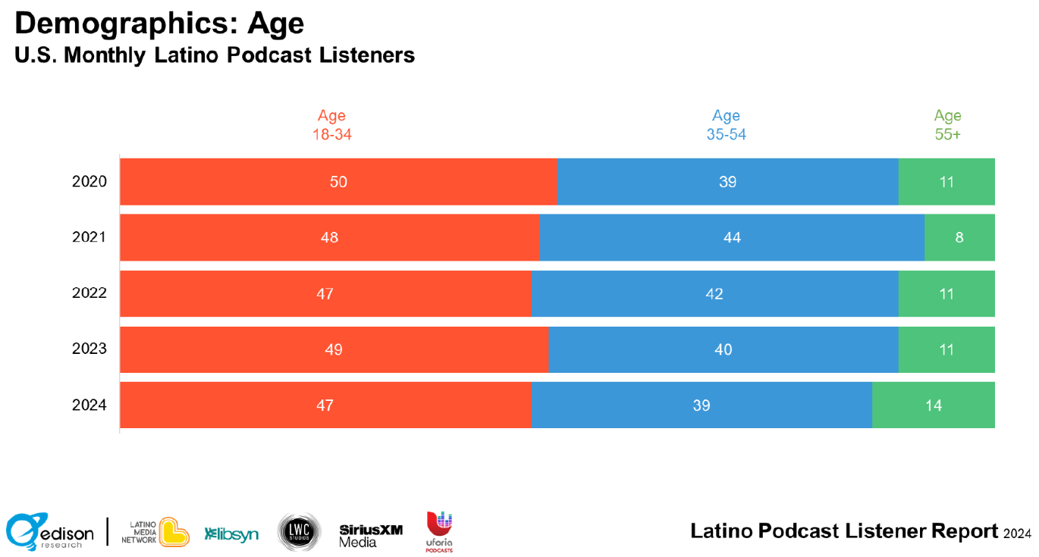
Appendix B
Notes:
Edison Research. (2024). Latino Podcast Listener Report 2024. Retrieved from https://www.edisonresearch.com/the-latino-podcast-listener-report-2024/

Slide 13
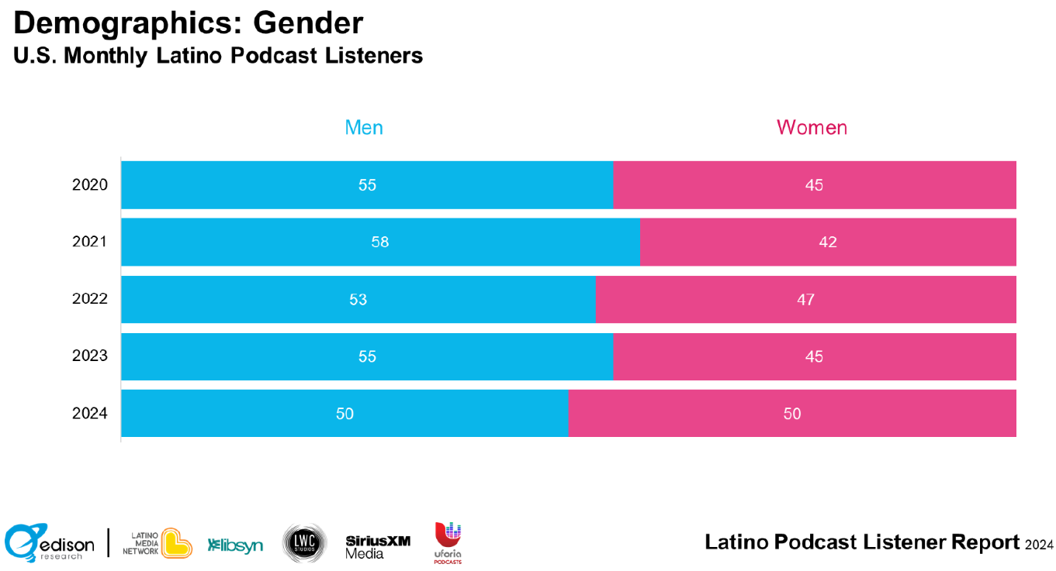
Appendix C
Notes:
Edison Research. (2024). Latino Podcast Listener Report 2024. Retrieved from https://www.edisonresearch.com/the-latino-podcast-listener-report-2024/

Slide 14
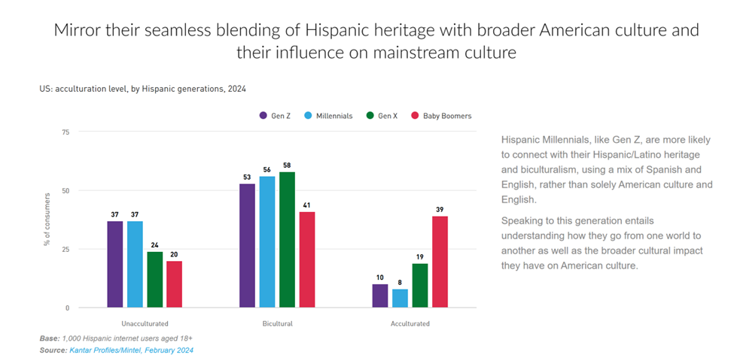
Appendix D
Notes:
Edison Research. (2024). Latino Podcast Listener Report 2024. Retrieved from https://www.edisonresearch.com/the-latino-podcast-listener-report-2024/

Slide 15
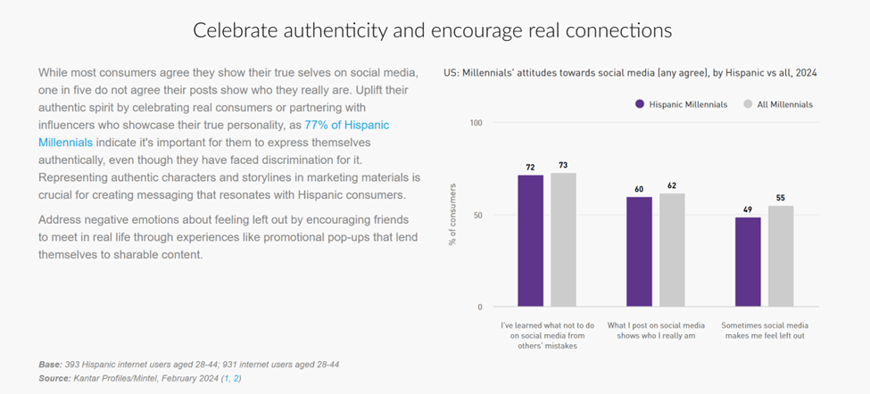
Appendix E

Slide 16
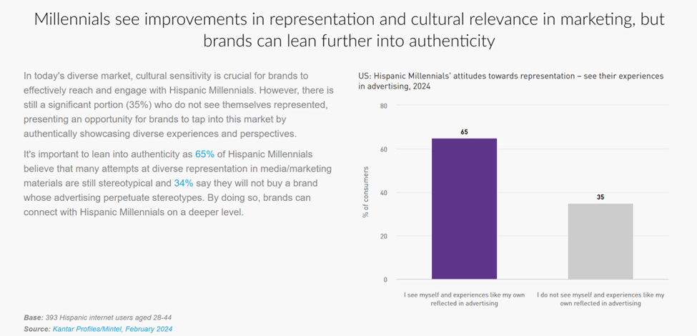
Appendix F

Slide 17
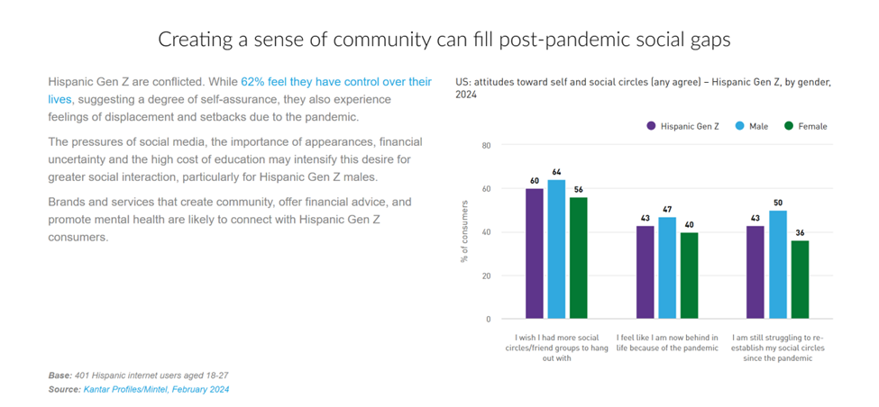
Appendix G

Slide 18
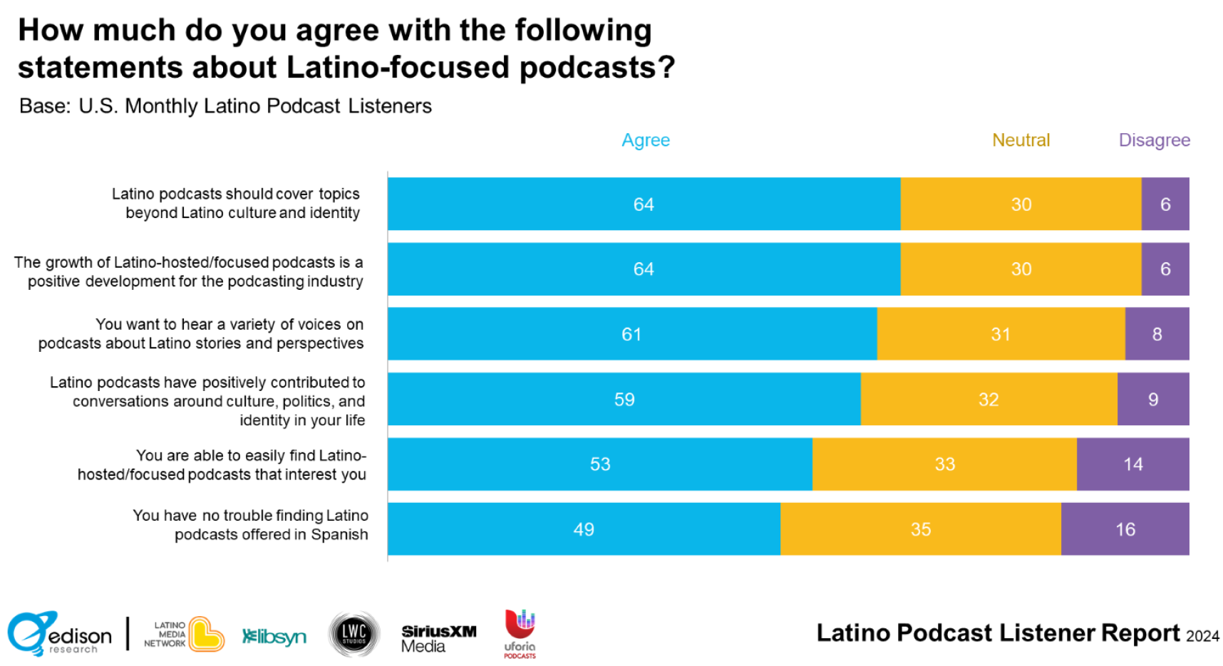
Appendix H

Slide 19
Appendix I
Category | Business Name | Location | Description
Cigar Brands | Tres Lindas Cubanas | Miami, FL | Afro-Cuban twin sisters’ cigar brand celebrating heritage and community storytelling.
 | Kafie 1901 Cigars | Honduras | Premium cigars and organic coffee brand rooted in tradition, founded by Dr. Gaby Kafie.
 | Maya Selva Cigars | Honduras/Nicaragua | Female-owned cigar company featuring blends like Flor de Selva and Cumpay.
Coffee | Cienfuegos Coffee | Miami, FL | Mobile Cuban coffee cart founded by Cuban-American Carina Zatarain.
 | Hacienda Lealtad | Lares, Puerto Rico | Historic plantation producing Café Lealtad with cultural coffee tours.
 | Caffeto Specialty Coffee | Manizales, Colombia / USA | Colombian coffee truck serving farm-direct coffee, rooted in family tradition.
Lifestyle | JZD | South Texas, USA | Latina lifestyle brand (now at Target) celebrating Latino identity through apparel and goods.
 | Nopalera | USA | Mexican-inspired beauty and bath brand offering artisanal soaps and skincare products.
 | Cielito Querido Café | Mexico | Stylish coffee chain inspired by Mexican history and traditional flavors.

Slide 20
Appendix J
Appendix: Content Creation Contest for Stay Tranquilo
This appendix outlines the Stay Tranquilo Content Creation Contest, designed to expand the brand's reach and engage new creators, particularly Latinas, to align with the brand’s new market positioning. The contest serves as a strategy for discovering fresh content ideas and potential creative partners.
Objective
The goal of this contest is to invite content creators to submit short videos that reflect how they "Stay Tranquilo." This will help expand Stay Tranquilo’s social presence, inspire new content formats, and identify potential collaborators.
Contest Overview
Name: “How Do You Stay Tranquilo?”
Format: A contest for content creators to submit a 30-60 second video that expresses how they embody the Stay Tranquilo philosophy.
Target Audience: Primarily Latinas, but open to all creators who resonate with Stay Tranquilo’s message of wellness, positivity, and cultural pride.
Submission Platform: Social media channels (Instagram, TikTok, YouTube) and a dedicated contest landing page on Stay Tranquilo’s website.
Notes:
Appendix: Content Creation Contest for Stay Tranquilo
This appendix outlines the Stay Tranquilo Content Creation Contest, designed to expand the brand's reach and engage new creators, particularly Latinas, to align with the brand’s new market positioning. The contest serves as a strategy for discovering fresh content ideas and potential creative partners.
Objective
The goal of this contest is to invite content creators to submit short videos that reflect how they "Stay Tranquilo." This will help expand Stay Tranquilo’s social presence, inspire new content formats, and identify potential collaborators.
Contest Overview
Name: “How Do You Stay Tranquilo?”
Format: A contest for content creators to submit a 30-60 second video that expresses how they embody the Stay Tranquilo philosophy.
Target Audience: Primarily Latinas, but open to all creators who resonate with Stay Tranquilo’s message of wellness, positivity, and cultural pride.
Submission Platform: Social media channels (Instagram, TikTok, YouTube) and a dedicated contest landing page on Stay Tranquilo’s website.
Key Steps for the Contest
Announcement & Promotion
When: Early 2026
Where: Promote the contest via Stay Tranquilo's social media channels, podcast episodes, and email newsletters.
Partnerships: Collaborate with influencers, especially Latina creators, to promote the contest and generate interest.
Content Guidelines: Participants must submit a 30-60 second video showcasing their interpretation of the Stay Tranquilo philosophy.
Submission Process
Participants upload their videos on their preferred platform (Instagram, TikTok, YouTube).
Submissions should include a hashtag (e.g., #StayTranquiloContest) to track entries and generate social media buzz.
A clear call-to-action (CTA) inviting people to enter and follow Stay Tranquilo on social media for updates.
Selection Criteria
Creativity: How innovative and unique the content is in representing the Stay Tranquilo message.
Engagement: Number of likes, comments, shares, and how well the content resonates with the audience.
Authenticity: How well the video reflects Stay Tranquilo's cultural values and brand voice.
Potential for Partnership: Whether the creator shows promise as a future collaborator for Stay Tranquilo.
Judging Panel
A panel consisting of Stay Tranquilo’s leadership, key influencers, and brand ambassadors will judge the submissions.
Feedback from the panel will be provided to participants for future content development and collaboration opportunities.
Prizes & Rewards
First Prize: Feature the winner's video on Stay Tranquilo’s official channels, offer them an internship, or hire them as a creative partner.
Runner-up Prizes: Merchandise, shout-outs on social media, and opportunities for future collaborations.
Community Engagement: Engage the community by allowing the public to vote for their favorite entries, adding an element of crowd participation.
Post-Contest Actions
Content Creation: Work with the winners to produce high-quality content for Stay Tranquilo’s platforms.
Expand Brand Reach: Utilize the new content to increase Stay Tranquilo’s social media presence and engage with a broader audience.
Partnerships: For those with significant audience engagement, consider long-term collaboration or brand ambassador roles.
Conclusion
The Stay Tranquilo Content Creation Contest offers a unique opportunity to tap into the creative potential of the audience, especially Latina content creators. By fostering this kind of engagement, Stay Tranquilo not only increases its social media presence but also identifies potential partners who align with the brand's cultural values and market goals.

Slide 21
Appendix J
Key Steps for the Contest (Part 1)
Announcement & Promotion
When: Early 2026
Where: Promote the contest via Stay Tranquilo's social media channels, podcast episodes, and email newsletters.
Partnerships: Collaborate with influencers, especially Latina creators, to promote the contest and generate interest.
Content Guidelines: Participants must submit a 30-60 second video showcasing their interpretation of the Stay Tranquilo philosophy.
Submission Process
Participants upload their videos on their preferred platform (Instagram, TikTok, YouTube).
Submissions should include a hashtag (e.g., #StayTranquiloContest) to track entries and generate social media buzz.
A clear call-to-action (CTA) inviting people to enter and follow Stay Tranquilo on social media for updates.
Notes:
Appendix: Content Creation Contest for Stay Tranquilo
This appendix outlines the Stay Tranquilo Content Creation Contest, designed to expand the brand's reach and engage new creators, particularly Latinas, to align with the brand’s new market positioning. The contest serves as a strategy for discovering fresh content ideas and potential creative partners.
Objective
The goal of this contest is to invite content creators to submit short videos that reflect how they "Stay Tranquilo." This will help expand Stay Tranquilo’s social presence, inspire new content formats, and identify potential collaborators.
Contest Overview
Name: “How Do You Stay Tranquilo?”
Format: A contest for content creators to submit a 30-60 second video that expresses how they embody the Stay Tranquilo philosophy.
Target Audience: Primarily Latinas, but open to all creators who resonate with Stay Tranquilo’s message of wellness, positivity, and cultural pride.
Submission Platform: Social media channels (Instagram, TikTok, YouTube) and a dedicated contest landing page on Stay Tranquilo’s website.
Key Steps for the Contest
Announcement & Promotion
When: Early 2026
Where: Promote the contest via Stay Tranquilo's social media channels, podcast episodes, and email newsletters.
Partnerships: Collaborate with influencers, especially Latina creators, to promote the contest and generate interest.
Content Guidelines: Participants must submit a 30-60 second video showcasing their interpretation of the Stay Tranquilo philosophy.
Submission Process
Participants upload their videos on their preferred platform (Instagram, TikTok, YouTube).
Submissions should include a hashtag (e.g., #StayTranquiloContest) to track entries and generate social media buzz.
A clear call-to-action (CTA) inviting people to enter and follow Stay Tranquilo on social media for updates.
Selection Criteria
Creativity: How innovative and unique the content is in representing the Stay Tranquilo message.
Engagement: Number of likes, comments, shares, and how well the content resonates with the audience.
Authenticity: How well the video reflects Stay Tranquilo's cultural values and brand voice.
Potential for Partnership: Whether the creator shows promise as a future collaborator for Stay Tranquilo.
Judging Panel
A panel consisting of Stay Tranquilo’s leadership, key influencers, and brand ambassadors will judge the submissions.
Feedback from the panel will be provided to participants for future content development and collaboration opportunities.
Prizes & Rewards
First Prize: Feature the winner's video on Stay Tranquilo’s official channels, offer them an internship, or hire them as a creative partner.
Runner-up Prizes: Merchandise, shout-outs on social media, and opportunities for future collaborations.
Community Engagement: Engage the community by allowing the public to vote for their favorite entries, adding an element of crowd participation.
Post-Contest Actions
Content Creation: Work with the winners to produce high-quality content for Stay Tranquilo’s platforms.
Expand Brand Reach: Utilize the new content to increase Stay Tranquilo’s social media presence and engage with a broader audience.
Partnerships: For those with significant audience engagement, consider long-term collaboration or brand ambassador roles.
Conclusion
The Stay Tranquilo Content Creation Contest offers a unique opportunity to tap into the creative potential of the audience, especially Latina content creators. By fostering this kind of engagement, Stay Tranquilo not only increases its social media presence but also identifies potential partners who align with the brand's cultural values and market goals.

Slide 22
Appendix J
Key Steps for the Contest (Part 2)
Selection Criteria
Creativity: How innovative and unique the content is in representing the Stay Tranquilo message.
Engagement: Number of likes, comments, shares, and how well the content resonates with the audience.
Authenticity: How well the video reflects Stay Tranquilo's cultural values and brand voice.
Potential for Partnership: Whether the creator shows promise as a future collaborator for Stay Tranquilo.
Judging Panel
A panel consisting of Stay Tranquilo’s leadership, key influencers, and brand ambassadors will judge the submissions.
Feedback from the panel will be provided to participants for future content development and collaboration opportunities.
Notes:
Appendix: Content Creation Contest for Stay Tranquilo
This appendix outlines the Stay Tranquilo Content Creation Contest, designed to expand the brand's reach and engage new creators, particularly Latinas, to align with the brand’s new market positioning. The contest serves as a strategy for discovering fresh content ideas and potential creative partners.
Objective
The goal of this contest is to invite content creators to submit short videos that reflect how they "Stay Tranquilo." This will help expand Stay Tranquilo’s social presence, inspire new content formats, and identify potential collaborators.
Contest Overview
Name: “How Do You Stay Tranquilo?”
Format: A contest for content creators to submit a 30-60 second video that expresses how they embody the Stay Tranquilo philosophy.
Target Audience: Primarily Latinas, but open to all creators who resonate with Stay Tranquilo’s message of wellness, positivity, and cultural pride.
Submission Platform: Social media channels (Instagram, TikTok, YouTube) and a dedicated contest landing page on Stay Tranquilo’s website.
Key Steps for the Contest
Announcement & Promotion
When: Early 2026
Where: Promote the contest via Stay Tranquilo's social media channels, podcast episodes, and email newsletters.
Partnerships: Collaborate with influencers, especially Latina creators, to promote the contest and generate interest.
Content Guidelines: Participants must submit a 30-60 second video showcasing their interpretation of the Stay Tranquilo philosophy.
Submission Process
Participants upload their videos on their preferred platform (Instagram, TikTok, YouTube).
Submissions should include a hashtag (e.g., #StayTranquiloContest) to track entries and generate social media buzz.
A clear call-to-action (CTA) inviting people to enter and follow Stay Tranquilo on social media for updates.
Selection Criteria
Creativity: How innovative and unique the content is in representing the Stay Tranquilo message.
Engagement: Number of likes, comments, shares, and how well the content resonates with the audience.
Authenticity: How well the video reflects Stay Tranquilo's cultural values and brand voice.
Potential for Partnership: Whether the creator shows promise as a future collaborator for Stay Tranquilo.
Judging Panel
A panel consisting of Stay Tranquilo’s leadership, key influencers, and brand ambassadors will judge the submissions.
Feedback from the panel will be provided to participants for future content development and collaboration opportunities.
Prizes & Rewards
First Prize: Feature the winner's video on Stay Tranquilo’s official channels, offer them an internship, or hire them as a creative partner.
Runner-up Prizes: Merchandise, shout-outs on social media, and opportunities for future collaborations.
Community Engagement: Engage the community by allowing the public to vote for their favorite entries, adding an element of crowd participation.
Post-Contest Actions
Content Creation: Work with the winners to produce high-quality content for Stay Tranquilo’s platforms.
Expand Brand Reach: Utilize the new content to increase Stay Tranquilo’s social media presence and engage with a broader audience.
Partnerships: For those with significant audience engagement, consider long-term collaboration or brand ambassador roles.
Conclusion
The Stay Tranquilo Content Creation Contest offers a unique opportunity to tap into the creative potential of the audience, especially Latina content creators. By fostering this kind of engagement, Stay Tranquilo not only increases its social media presence but also identifies potential partners who align with the brand's cultural values and market goals.

Slide 23
Appendix J
Key Steps for the Contest (Part 3)
Prizes & Rewards
First Prize: Feature the winner's video on Stay Tranquilo’s official channels, offer them an internship, or hire them as a creative partner.
Runner-up Prizes: Merchandise, shout-outs on social media, and opportunities for future collaborations.
Community Engagement: Engage the community by allowing the public to vote for their favorite entries, adding an element of crowd participation.
Post-Contest Actions
Content Creation: Work with the winners to produce high-quality content for Stay Tranquilo’s platforms.
Expand Brand Reach: Utilize the new content to increase Stay Tranquilo’s social media presence and engage with a broader audience.
Partnerships: For those with significant audience engagement, consider long-term collaboration or brand ambassador roles.
Notes:
Appendix: Content Creation Contest for Stay Tranquilo
This appendix outlines the Stay Tranquilo Content Creation Contest, designed to expand the brand's reach and engage new creators, particularly Latinas, to align with the brand’s new market positioning. The contest serves as a strategy for discovering fresh content ideas and potential creative partners.
Objective
The goal of this contest is to invite content creators to submit short videos that reflect how they "Stay Tranquilo." This will help expand Stay Tranquilo’s social presence, inspire new content formats, and identify potential collaborators.
Contest Overview
Name: “How Do You Stay Tranquilo?”
Format: A contest for content creators to submit a 30-60 second video that expresses how they embody the Stay Tranquilo philosophy.
Target Audience: Primarily Latinas, but open to all creators who resonate with Stay Tranquilo’s message of wellness, positivity, and cultural pride.
Submission Platform: Social media channels (Instagram, TikTok, YouTube) and a dedicated contest landing page on Stay Tranquilo’s website.
Key Steps for the Contest
Announcement & Promotion
When: Early 2026
Where: Promote the contest via Stay Tranquilo's social media channels, podcast episodes, and email newsletters.
Partnerships: Collaborate with influencers, especially Latina creators, to promote the contest and generate interest.
Content Guidelines: Participants must submit a 30-60 second video showcasing their interpretation of the Stay Tranquilo philosophy.
Submission Process
Participants upload their videos on their preferred platform (Instagram, TikTok, YouTube).
Submissions should include a hashtag (e.g., #StayTranquiloContest) to track entries and generate social media buzz.
A clear call-to-action (CTA) inviting people to enter and follow Stay Tranquilo on social media for updates.
Selection Criteria
Creativity: How innovative and unique the content is in representing the Stay Tranquilo message.
Engagement: Number of likes, comments, shares, and how well the content resonates with the audience.
Authenticity: How well the video reflects Stay Tranquilo's cultural values and brand voice.
Potential for Partnership: Whether the creator shows promise as a future collaborator for Stay Tranquilo.
Judging Panel
A panel consisting of Stay Tranquilo’s leadership, key influencers, and brand ambassadors will judge the submissions.
Feedback from the panel will be provided to participants for future content development and collaboration opportunities.
Prizes & Rewards
First Prize: Feature the winner's video on Stay Tranquilo’s official channels, offer them an internship, or hire them as a creative partner.
Runner-up Prizes: Merchandise, shout-outs on social media, and opportunities for future collaborations.
Community Engagement: Engage the community by allowing the public to vote for their favorite entries, adding an element of crowd participation.
Post-Contest Actions
Content Creation: Work with the winners to produce high-quality content for Stay Tranquilo’s platforms.
Expand Brand Reach: Utilize the new content to increase Stay Tranquilo’s social media presence and engage with a broader audience.
Partnerships: For those with significant audience engagement, consider long-term collaboration or brand ambassador roles.
Conclusion
The Stay Tranquilo Content Creation Contest offers a unique opportunity to tap into the creative potential of the audience, especially Latina content creators. By fostering this kind of engagement, Stay Tranquilo not only increases its social media presence but also identifies potential partners who align with the brand's cultural values and market goals.

Slide 24
Appendix J
Key Steps for the Contest (Part 4)
Conclusion
The Stay Tranquilo Content Creation Contest offers a unique opportunity to tap into the creative potential of the audience, especially Latina content creators. By fostering this kind of engagement, Stay Tranquilo not only increases its social media presence but also identifies potential partners who align with the brand's cultural values and market goals.
Notes:
Appendix: Content Creation Contest for Stay Tranquilo
This appendix outlines the Stay Tranquilo Content Creation Contest, designed to expand the brand's reach and engage new creators, particularly Latinas, to align with the brand’s new market positioning. The contest serves as a strategy for discovering fresh content ideas and potential creative partners.
Objective
The goal of this contest is to invite content creators to submit short videos that reflect how they "Stay Tranquilo." This will help expand Stay Tranquilo’s social presence, inspire new content formats, and identify potential collaborators.
Contest Overview
Name: “How Do You Stay Tranquilo?”
Format: A contest for content creators to submit a 30-60 second video that expresses how they embody the Stay Tranquilo philosophy.
Target Audience: Primarily Latinas, but open to all creators who resonate with Stay Tranquilo’s message of wellness, positivity, and cultural pride.
Submission Platform: Social media channels (Instagram, TikTok, YouTube) and a dedicated contest landing page on Stay Tranquilo’s website.
Key Steps for the Contest
Announcement & Promotion
When: Early 2026
Where: Promote the contest via Stay Tranquilo's social media channels, podcast episodes, and email newsletters.
Partnerships: Collaborate with influencers, especially Latina creators, to promote the contest and generate interest.
Content Guidelines: Participants must submit a 30-60 second video showcasing their interpretation of the Stay Tranquilo philosophy.
Submission Process
Participants upload their videos on their preferred platform (Instagram, TikTok, YouTube).
Submissions should include a hashtag (e.g., #StayTranquiloContest) to track entries and generate social media buzz.
A clear call-to-action (CTA) inviting people to enter and follow Stay Tranquilo on social media for updates.
Selection Criteria
Creativity: How innovative and unique the content is in representing the Stay Tranquilo message.
Engagement: Number of likes, comments, shares, and how well the content resonates with the audience.
Authenticity: How well the video reflects Stay Tranquilo's cultural values and brand voice.
Potential for Partnership: Whether the creator shows promise as a future collaborator for Stay Tranquilo.
Judging Panel
A panel consisting of Stay Tranquilo’s leadership, key influencers, and brand ambassadors will judge the submissions.
Feedback from the panel will be provided to participants for future content development and collaboration opportunities.
Prizes & Rewards
First Prize: Feature the winner's video on Stay Tranquilo’s official channels, offer them an internship, or hire them as a creative partner.
Runner-up Prizes: Merchandise, shout-outs on social media, and opportunities for future collaborations.
Community Engagement: Engage the community by allowing the public to vote for their favorite entries, adding an element of crowd participation.
Post-Contest Actions
Content Creation: Work with the winners to produce high-quality content for Stay Tranquilo’s platforms.
Expand Brand Reach: Utilize the new content to increase Stay Tranquilo’s social media presence and engage with a broader audience.
Partnerships: For those with significant audience engagement, consider long-term collaboration or brand ambassador roles.
Conclusion
The Stay Tranquilo Content Creation Contest offers a unique opportunity to tap into the creative potential of the audience, especially Latina content creators. By fostering this kind of engagement, Stay Tranquilo not only increases its social media presence but also identifies potential partners who align with the brand's cultural values and market goals.

Slide 25
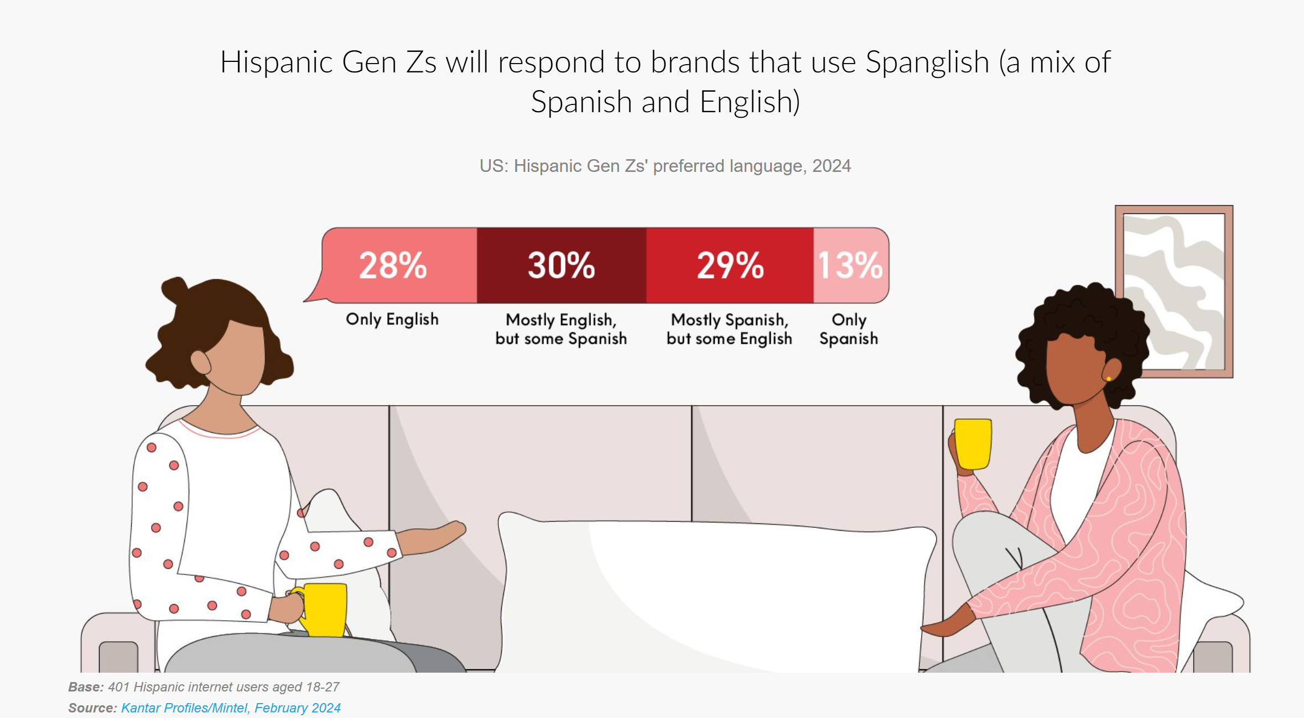
Appendix K

